Slide 1
Digital Attack Map
http://www.digitalattackmap.com/
Top daily DDoS attacks worldwide

Slide 2
What does Digital Attack Map perform?
Live Visualization of DDoS attacks around the globe.
Google Ideas + Big Picture + Arbor
Google Ideas : Protecting the people from online harassment. (Build new technology to mitigate the threats)
Big Picture : They blend algorithmic, data-driven approaches with fluid design to make complex data more accessible.
ARBOR : Provide DDoS attack data.

Slide 3
What is a DDoS attack ?
A Distributed Denial of Service (DDoS) attack is an attempt to make an online service unavailable by overwhelming it with traffic from multiple sources.

Slide 5
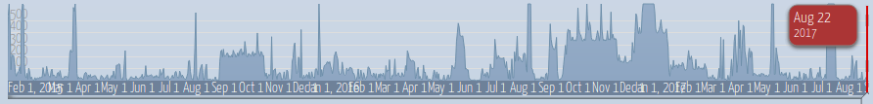
Exploring Data
Use the histogram at the bottom of the map to explore historical data.

Slide 6
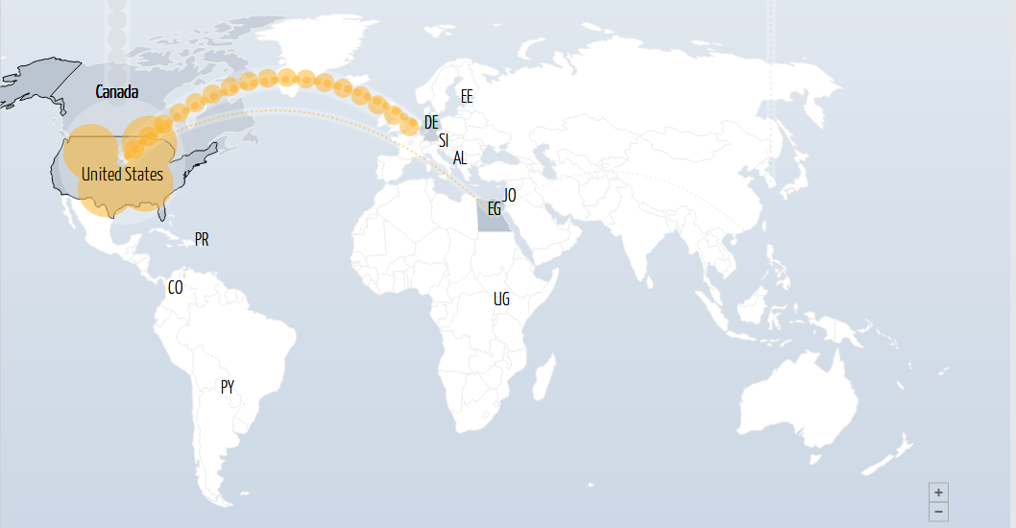
Exploring Data
Select a country to view DDoS activity to or from that country.

Slide 7
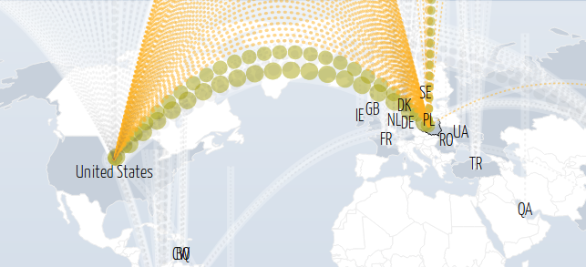
Exploring Data
Use the color option to view attacks by class, duration, or source/destination port.

Slide 8
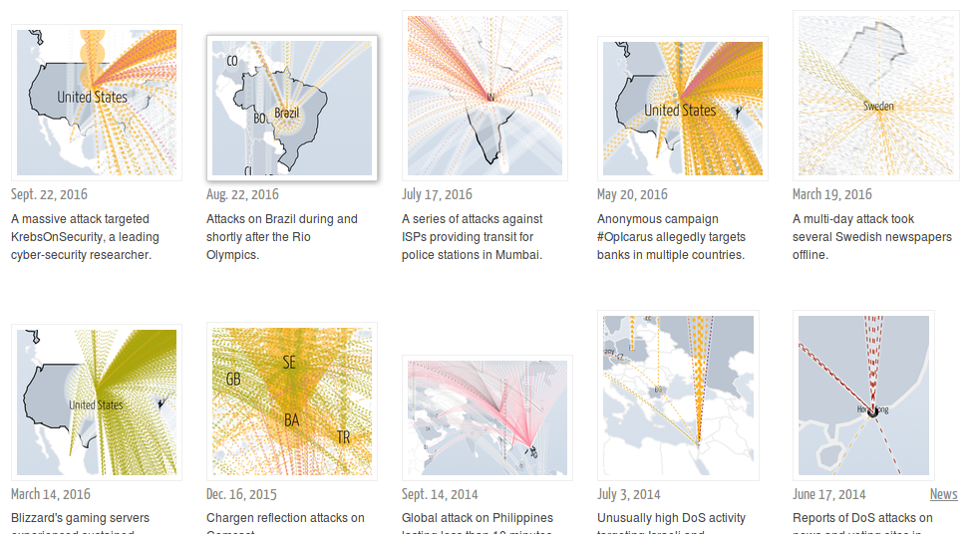
Exploring Data
Use the news section to find online reports of attack activity from a specified time.

Slide 9
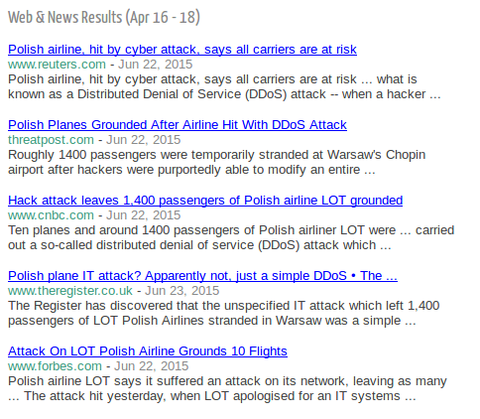
Exploring Data
View the gallery to explore some examples of days with notable DDoS attacks.

Slide 10
Examples of DDoS attacks
Smurfs
Large number of ICMP message can slow down the victims computer/server.
Teardrops
Sending oversized payloads to the target machine to crash.
Ping of Death
Make the buffer to overflow which can crash the system.

Slide 11
Types of Attacks in Digital Map
TCP Connection Attack
Volumetric Attack
Fragmentation Attack
Application Attack

Slide 12

TCP Connection Attack
These attempt to use up all the available connections to infrastructure devices such as load-balancers, firewalls and application servers. Even devices capable of maintaining state on millions of connections can be taken down by these attacks.
E.g.

Slide 13

Volumetric Attack
These attempt to consume the bandwidth either within the target network/service, or between the target network/service and the rest of the Internet. These attacks are simply about causing congestion.
E.g.

Slide 14

Fragmentation Attack
These send a flood of TCP or UDP fragments to a victim, overwhelming the victim's ability to re-assemble the streams and severely reducing performance
E.g.

Slide 15
Application Attack
These attempt to overwhelm a specific aspect of an application or service and can be effective even with very few attacking machines generating a low traffic rate (making them difficult to detect and mitigate).
1. DNS Reflection - Small request, big reply
2. Chargen Reflection - Steady streams of text

